Slide 1
Computer graphics III –
Low-discrepancy sequences and quasi-Monte Carlo methods
Jaroslav Křivánek, MFF UK
Jaroslav.Krivanek@mff.cuni.cz

Slide 2
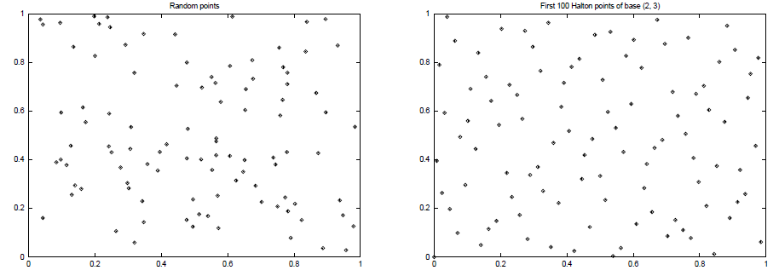
Quasi-Monte Carlo
Goal: Use point sequences that cover the integration domain as uniformly as possible, while keeping a ‘randomized’ look of the point set
High Discrepancy
(clusters of points)
Low Discrepancy
(more uniform)

Slide 3
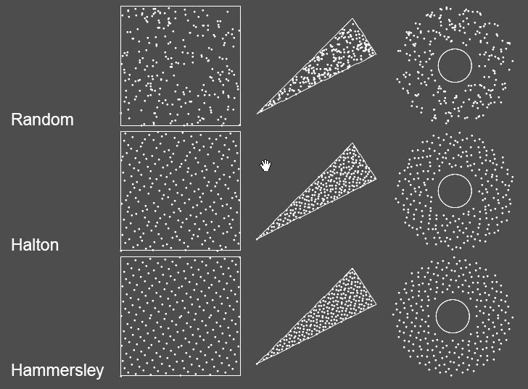
Transformation of point sets
Image credit: Alexander Keller

Slide 4
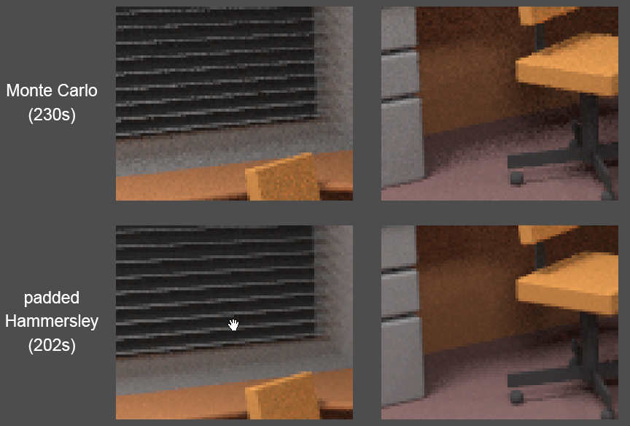
MC vs. QMC
Image credit: Alexander Keller

Slide 5
Quasi Monte Carlo (QMC) methods
Use of strictly deterministic sequences instead of random numbers
All formulas as in MC, just the underlying proofs cannot reply on the probability theory (nothing is random)
Based on sequences low-discrepancy sequences

Slide 6
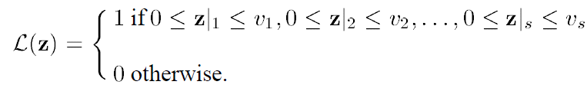

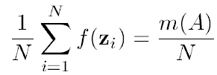
Defining discrepancy
s-dimensional “brick” function:
True volume of the “brick” function:
MC estimate of the volume of the “brick”:
number of sample points that
actually fell inside the “brick”
total number of sample points

Slide 7
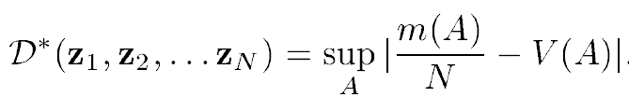
Discrepancy
Discrepancy (of a point sequence) is the maximum possible error of the MC quadrature of the “brick” function over all possible brick shapes:
  serves as a measure of the uniformity of a point set
  must converge to zero as N -> infty
  the lower the better (cf. Koksma-Hlawka Inequality)

Slide 8
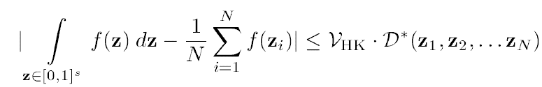
Koksma-Hlawka inequality
Koksma-Hlawka inequality
  the KH inequality only applies to f with finite variation
  QMC can still be applied even if the variation of f is infinite
„variation“ of f

Slide 9
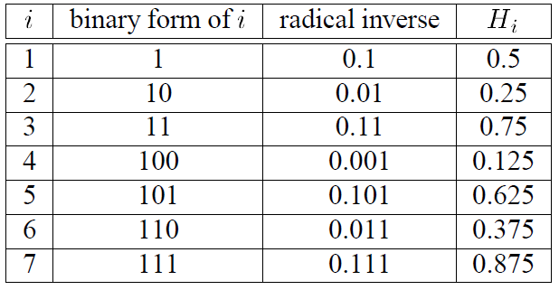
Van der Corput Sequence (base 2)
point placed in the middle of the interval
then the interval is divided in half
has low-discrepancy
Table credit: Laszlo Szirmay-Kalos

Slide 10
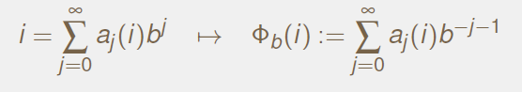
Van der Corput Sequence
b ... Base
radical inverse

Slide 11
Van der Corput Sequence (base b)
double radicalInverse(const int base, int i)
{
double digit, radical;
digit = radical = 1.0 / (double)base;
double inverse = 0.0;
while(i)
{
inverse += digit * (double)(i % base);
digit *= radical;
i /= base;
}
return inverse;
}

Slide 12
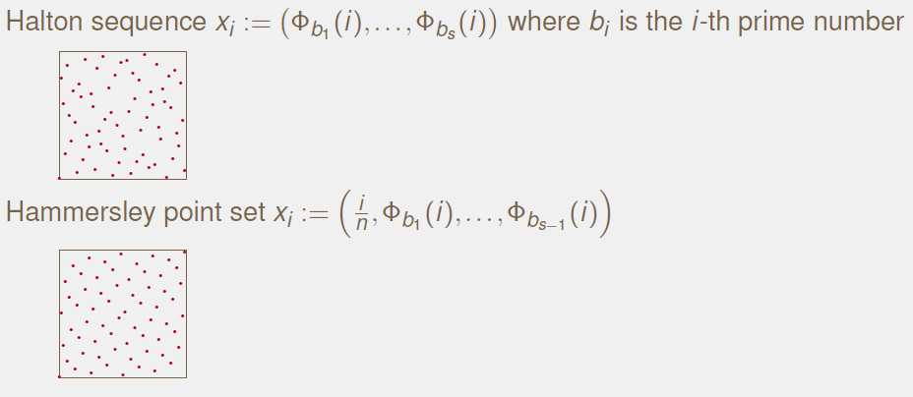
Sequences in higher dimension
Image credit: Alexander Keller

Slide 13
Use in path tracing
Objective: Generated paths should cover the entire high-dimensional path space uniformly
Approach:
  Paths are interpreted as “points” in a high-dimensional path space
  Each path is defined by a long vector of “random numbers”
    Subsequent random events along a single path use subsequent components of the same vector
  Only when tracing the next path, we switch to a brand new “random vector” (e.g. next vector from a Halton sequence)

Slide 14
Quasi-Monte Carlo (QMC) Methods
Disadvantages of QMC:
  Regular patterns can appear in the images (instead of the more acceptable noise in purely random MC)
  Random scrambling can be used to suppress it

Slide 15
Stratified sampling
Henrik Wann Jensen
10 paths per pixel

Slide 16
Quasi-Monte Carlo
Henrik Wann Jensen
10 paths per pixel

Slide 17
Fixní náhodná sekvence
Henrik Wann Jensen
10 paths per pixel

